Slide 1
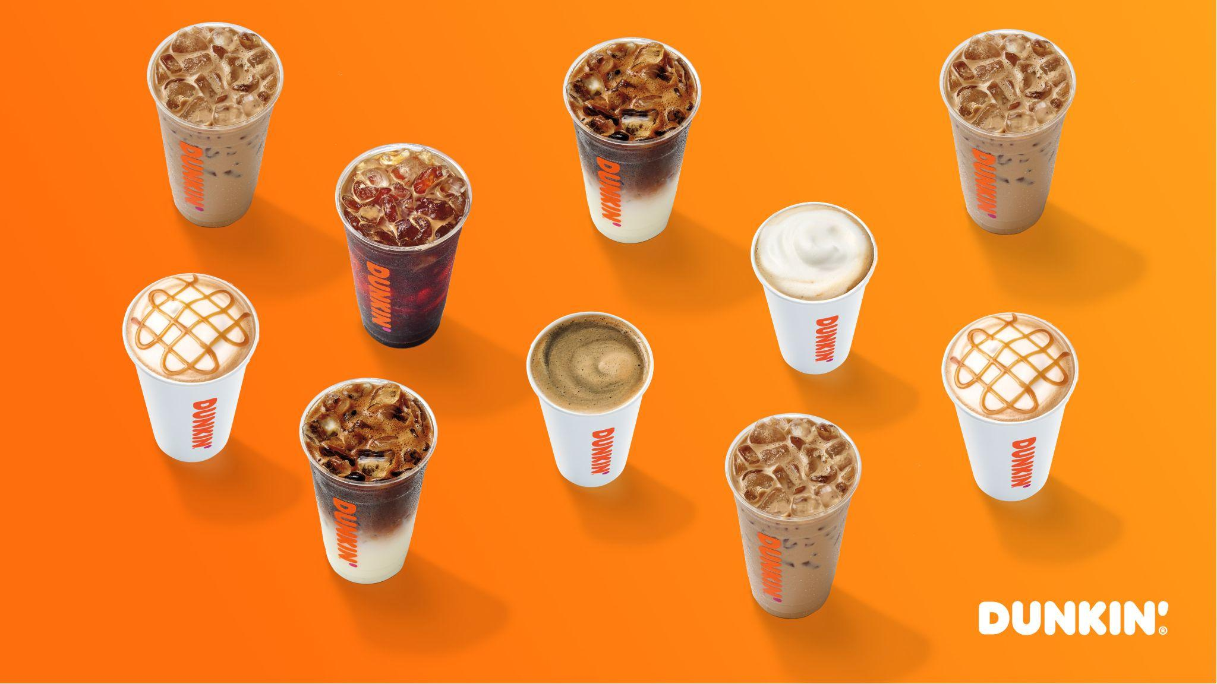
Dunkin Donuts Drive thru and In Store Operations
By: Thasin Wahid, Sharon Nancy, and Mazen Alhaffar
Thasin Wahid, Sharon Nancy, and Mazen Alhaffar

Slide 2
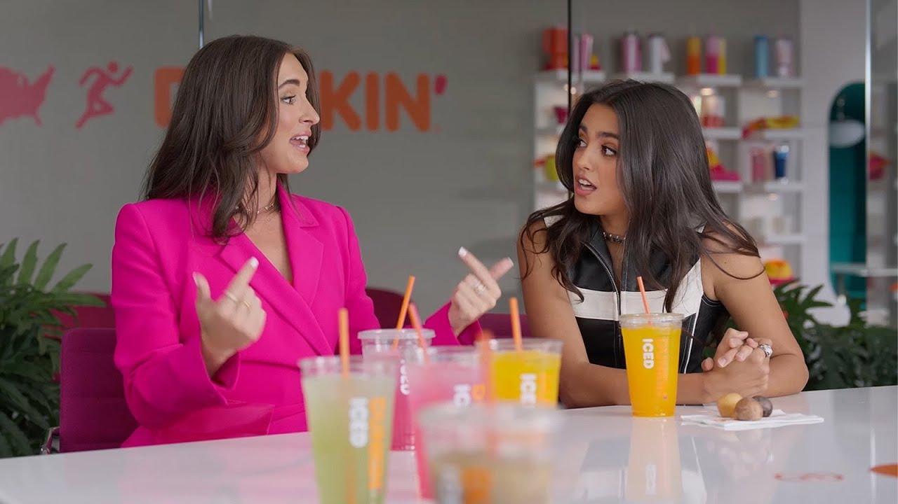
Table of Contents
01
02
03
Business Problem
Methodology
Model + Simulation
04
05
06
?
Results
Recommendations + Strategies
Conclusions + Questions

Slide 3
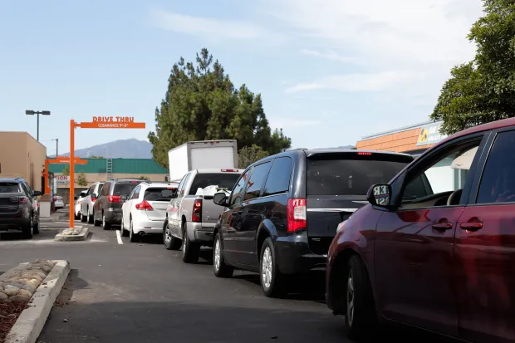
Business Problem
01
Long Wait Lines
Especially in drive thru (most popular option)
Unhappy customers
02
Customers may not be happy with waiting time and look for alternatives
03
Utilization
Poor Utilization of employees may lead to burnout and quitting and cost of hiring new employees is expensive

Slide 4
Research Question and Objective
Decrease Long Wait Times in Drive Thru specifically
While more customers is a desirable business outcome, we must find a way to reduce the time customers are waiting for their drive thru ordering
01
Maximize Employees
Find a way to increase usage of employees without overworking them and leading to burnout
02
Increase Revenue and Customer Satisfaction
The solution to all these goals must be cost effective to where we can increase revenue without leaving customers upset
03

Slide 5
Methodology
01
02
03
Observations
Assumptions
Data Collection
04
Results
Data Utilization

Slide 6
Observations and Assumptions
01
02
Observations
Assumptions
Spoke with store owner about observing real time data:
Inter arrival time of customers for drive thru and dine in
Queue times for waiting to order food
Processing time for employees of drive thru and dine in
Processing time includes taking order and making drink. We were informed triangular dist
Amount of customers who dined in vs to go
Store owner also supplied information on employee pay
We assume that all customers that arrive whether drive thru or in store will purchase a good
Homogeneous Behavior:
All customers behave similarly and follow the same path while at Dunkin
Fixed Service Capacities: The number of employees remains constant during the simulation

Slide 7
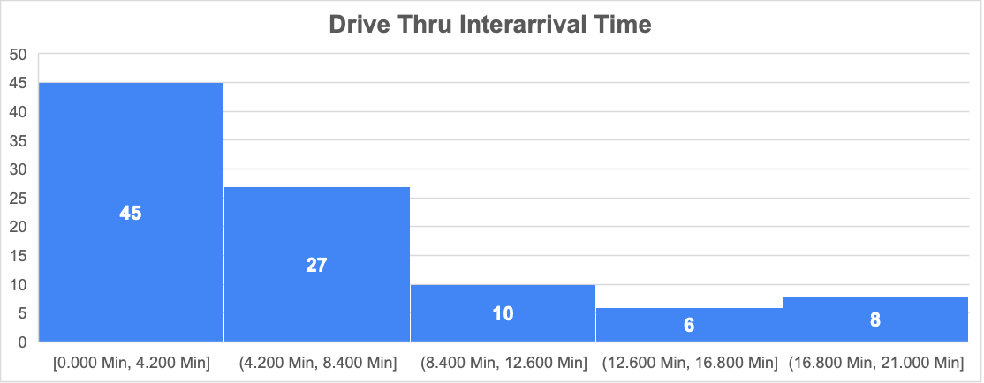
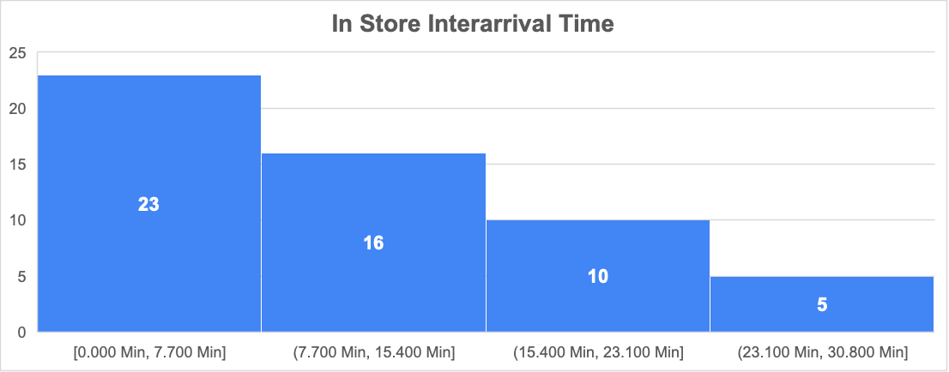
Data Collection and Data Utilization
Data Utilization (Determining Distribution)
Data Collection
04
03
Data Collection
Recording all data from observations and then creating statistical graphs to determine the distribution:
Customer arrival is exponential distribution
Processing time is triangular distribution
Choosing to dine in or take out once in store is discrete distribution

Slide 8
Model: Process Flow
Drive Thru
Customer exits line
Server collects money and hands customer good → triangular distribution
Customer receives products
Customer arrives, → exponential distribution
Waits in line to order
Employee takes order and makes drink → triangular distribution
Waits in line to receive good
In Store
Walks towards exit
To go
Customer leaves through front door
Customer arrives, exponential distribution
Waits in line to order
Employee takes order, makes drink, collects money and hands over drink → triangular distribution
Customer makes choice to dine in or to go
Dine in
Waits for free dine in table
Dine in table → capacity of 4

Slide 9
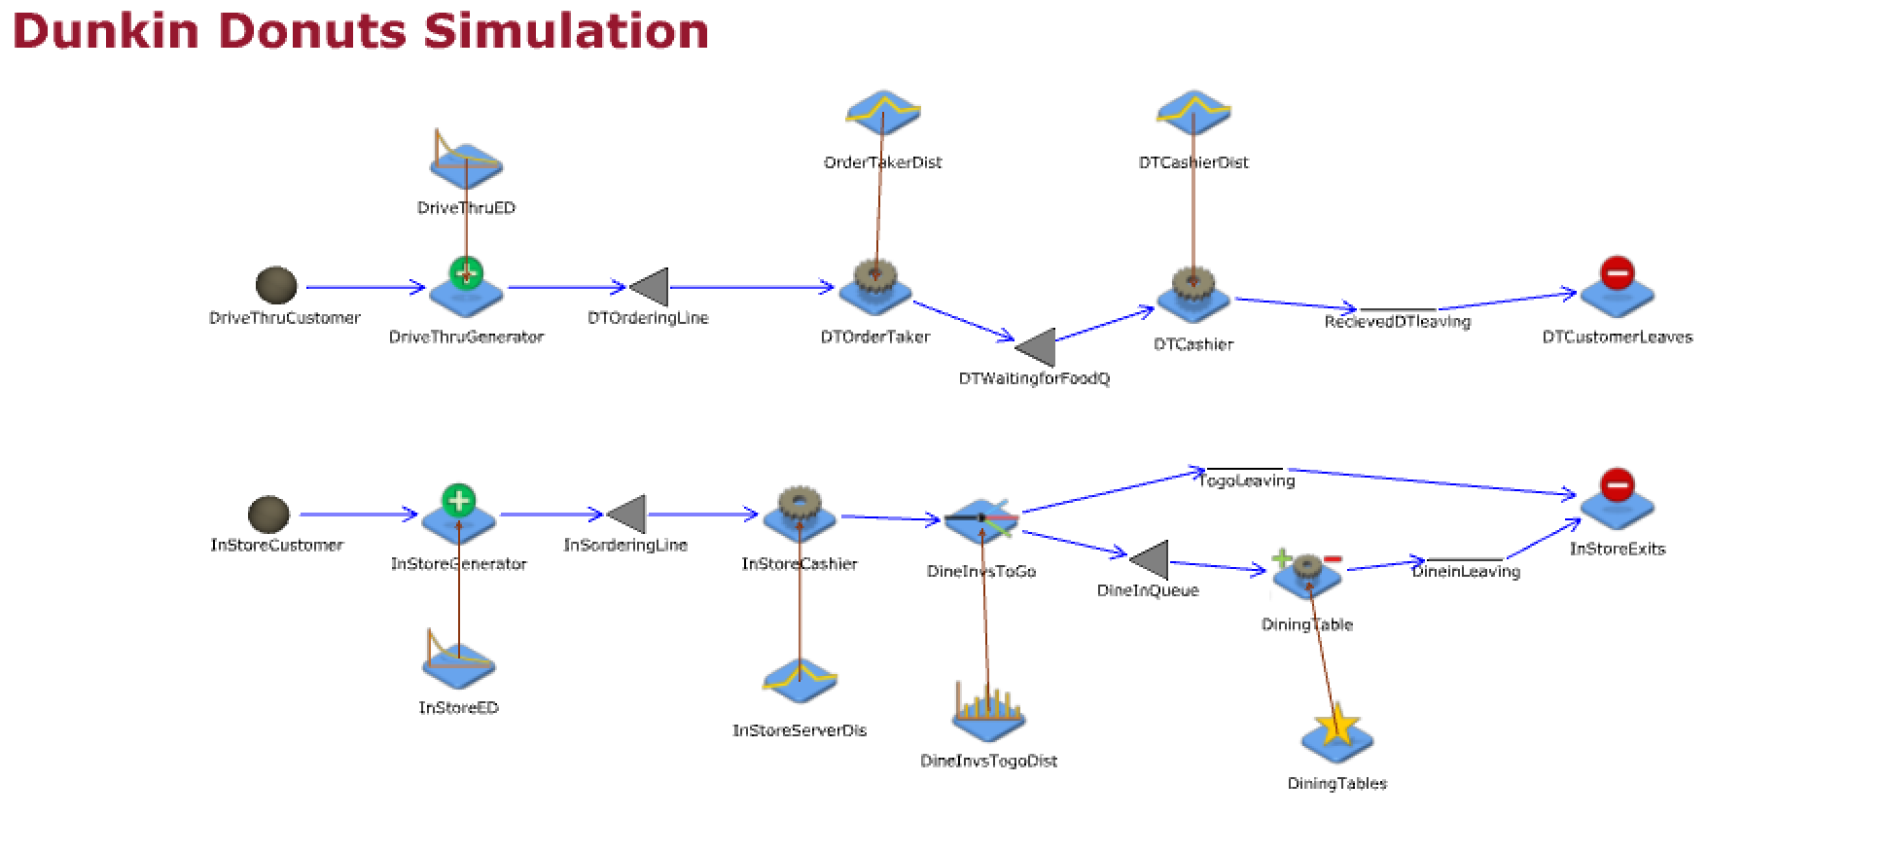
Model: JaamSim Simulation
Repetition - 10x
Duration - 8 hrs

Slide 10
Results
Number of Customers processed at Drive Thru | 95
Number of Customers processed In-store | 65
Queue Length for Drive Thru | 0.03
Queue Length for In-store | 0.01
Drive Thru Order Taker Utilization | 35.9%
Drive Thru Cashier Utilization | 37.9%
In-store Utilization | 52.8%
Dine in Customers | 13
To Go Customers | 52
Run Duration | 8 h
Store Hours | 5:00 AM - 9:00 PM

Slide 11
Recommendations + Strategies
The longest wait time and line occurs at the drive thru ordering process; therefore, by hiring a second employee at the Drive thru ordering process we can increase the amount of customers orders taken.
By hiring another employee, we will reduce wait times and increase profits and increase customer satisfaction
Based on interview with store owner, the pay rate for a Drive thru order taker is $8/hr. By adding an employee, we are confident it will be cost effective to hire and still make return on hire.
Since the in store customers are not as busy as drive thru, it does not make sense to hire an employee for the front counter at this time.
Most optimal solution would be to hire for Drive Thru order taker as that is the “bottleneck”.

Slide 12
Results from Improvements
Number of Customers processed at Drive Thru | 99
Number of Customers processed In-store | 65
Queue Length for Drive Thru | 0.0001
Queue Length for In-store | 0.01
Drive Thru Order Taker Utilization (Added Two Employees) | 62.4%
Drive Thru Cashier Utilization | 37.9%
In-store Utilization | 52.8%
Dine in Customers | 13
To Go Customers | 52
Run Duration | 8 h
Store Hours | 5:00 AM - 9:00 PM

Slide 13
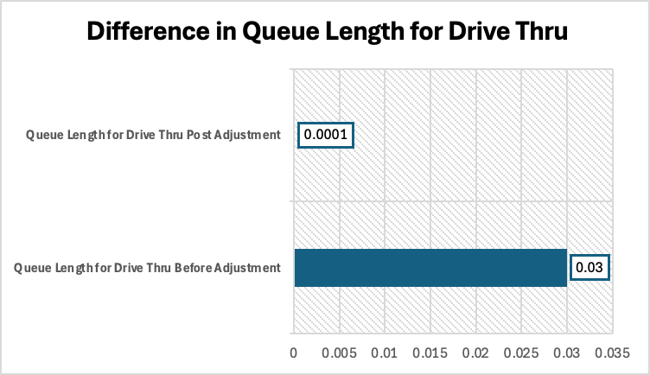
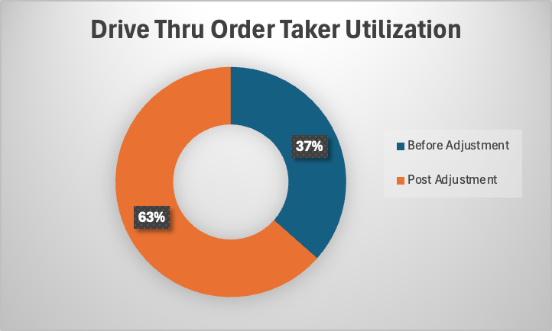
Improvement Summary

Slide 14
Conclusions
After improving the model by hiring a second employee for the drive thru ordering, we see decreased lengths in the waiting queue. The queue length decreases significantly from 0.03 to 0.0001. This is a 33% decrease which means faster times at drive thru allowing for more customers to join without waiting in line too long.
We also have a 74% improvement in employee utilization at the drive thru order taking processing which provides higher productivity
With the increased customers, there is an increased revenue which justifies hiring another employee
We can combat employee burnout by one employee handling all of drive thru orders and reduce the risk of them quitting which will also prevent the risk of employee leaving suddenly and the cost of onboarding and new hiring

Slide 15
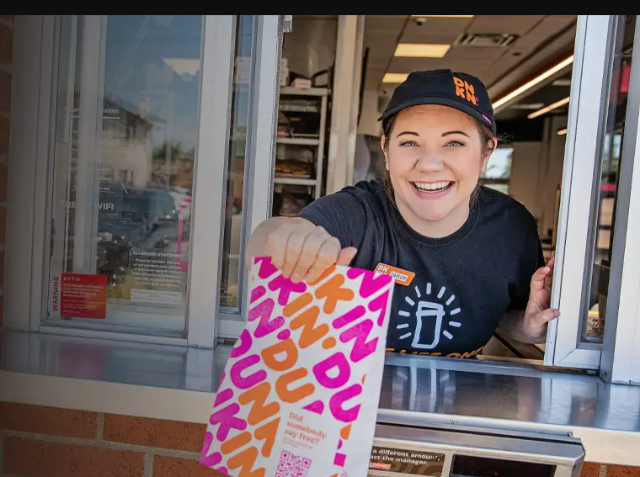
Thank you!

